Slide 1
Plant Cell Wall Decomposition by Fungi
BY ANDREW O. ARIAS AND WENKAI JIANG

Slide 2
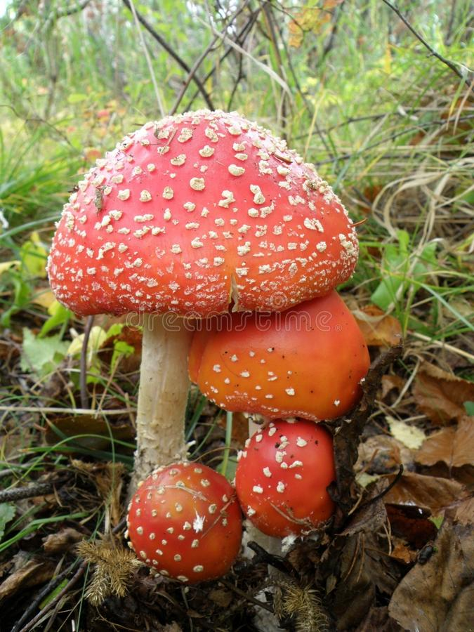
Question
What fungi order and/or species based on nutritional strategy are the best at decomposing certain types of plant cell wall component?
Why such question?
Fungi play key roles in soil ecosystems
Decomposers
Plant symbionts
Use as tools of bioremediation
Biotechnological use in medicine
Source of food (beer, bread, meat alternative etc.)
Spiritual rituals
Notes:
- Also they are able to eliminate pollutants from the soil by transforming harmful contaminant into benign products

Slide 3
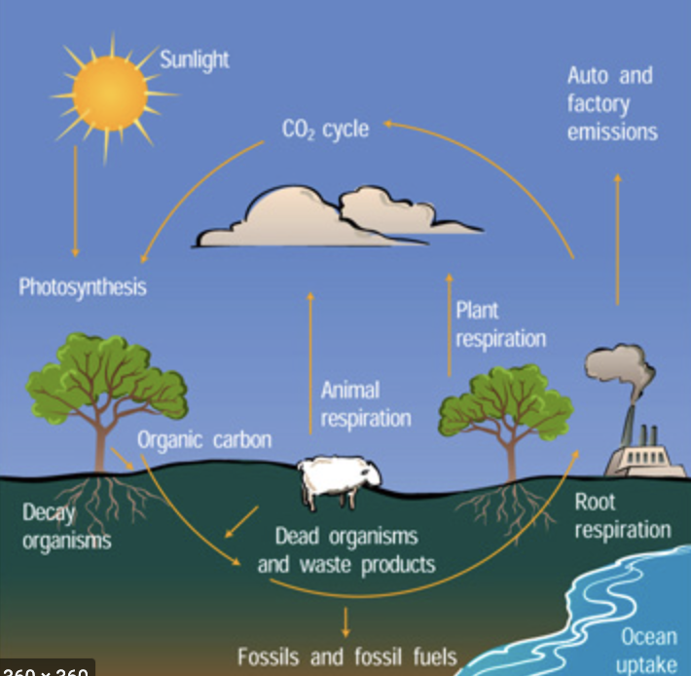
Background
What is Organic Matter (OM)?
- Microbial biomass + detritus + humus (weil and Bary, 2017)
Why is it important?
Food for microbes, recycling of nutrients, impact chemical and physical soil properties
Fungi Role?
Aid in decomposition of OM by secreting variety of hydrolytic and oxidative enzymes (Mayer et al., 2021)
Plant residues?
Main components consist of cellulose, hemicellulose, and lignin
Xenobiotics are substances present that are foregin to organism (Patterson, Gonzalez, & Idle, 2010)
Our Ideas ?
- What if we can find the best fungi that can breakdown and accelerate the decomposition of plant cell wall (PCW) material from agricultural practices and repurpose these materials.
Notes:
https://doi.org/10.1111/nph.17421
https://doi.org/10.1007/978-3-030-54422-5_8
-Repurpose these materials for the growth of other edible fungi, compost, or amendments for soil.

Slide 4

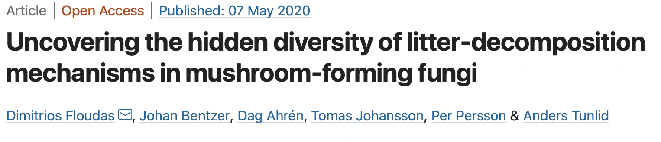
Dataset
Data was obtained from a study looking at uncovering the diversity of litter decomposing mushroom forming fungi.
Sample includes 42 different species of fungi
Independent variables are the number of genes related to breakdown of PCW components
Dependent variable is the predicted ability of fungi to breakdown PCW component due to number of genes
Notes:
Independent Variables: Number of genes of Cellulose, Hemicellulose, and Ligning/xenobiotics
These are continuous variables

Slide 5
Hypothesis
The more number of genes related to the decomposition of PCW compounds the more efficient the organism will be at breaking it down.
Notes:
PCW components= cellulose, hemicellulose, and ligning

Slide 6
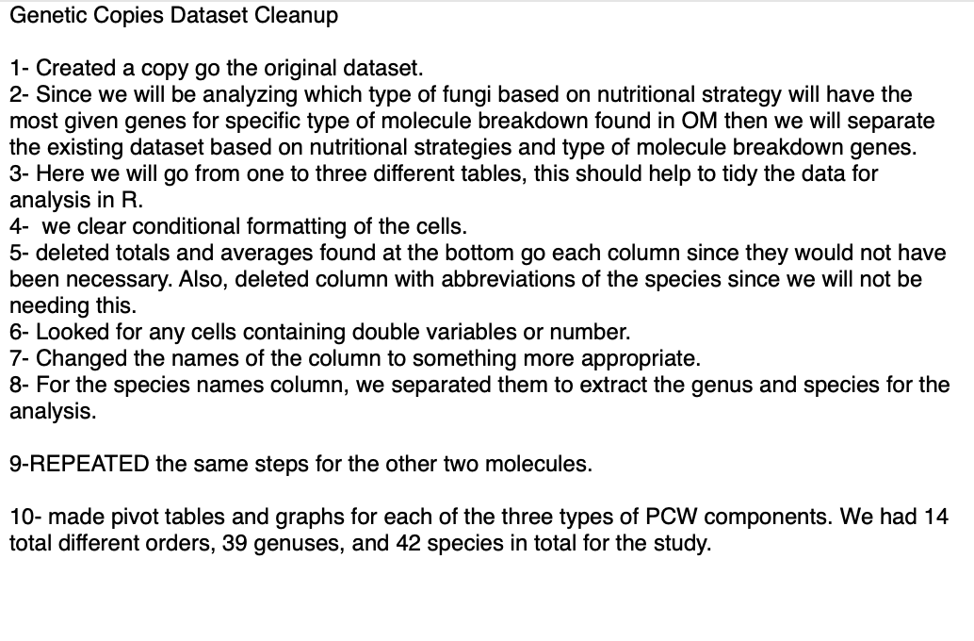
Methods
First steps was to tidy up the data and creating a text file to records the steps we took.
Notes:
Here we should add screenshots of the original dataset and then how we divided it

Slide 7
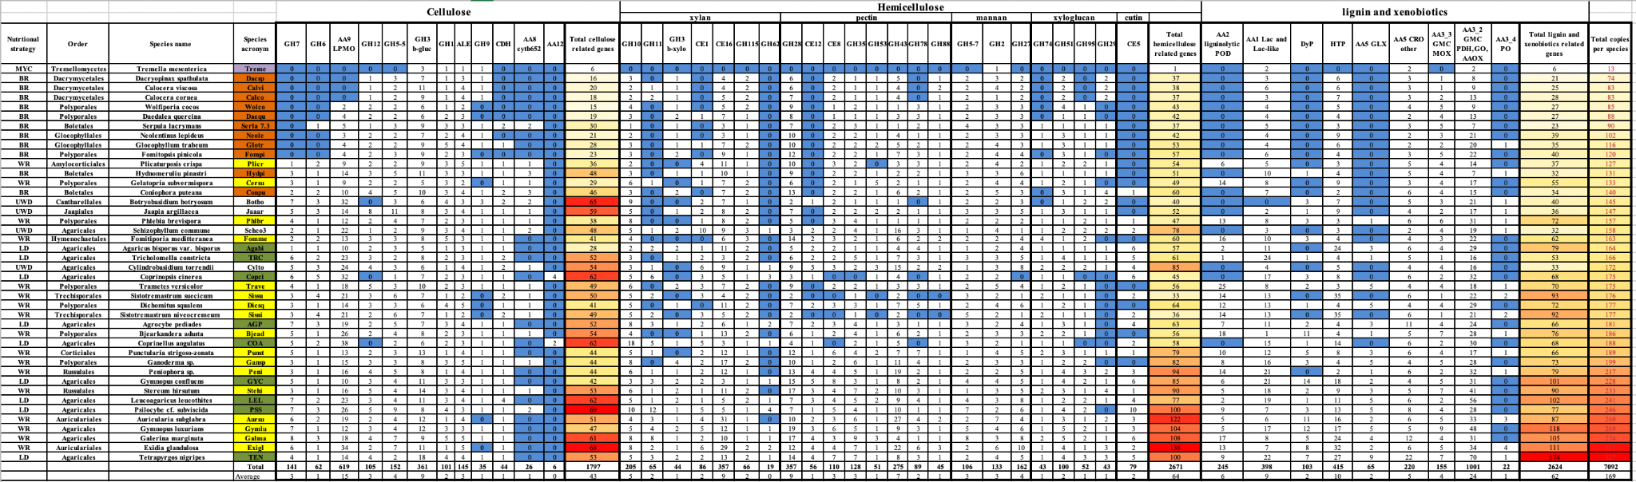
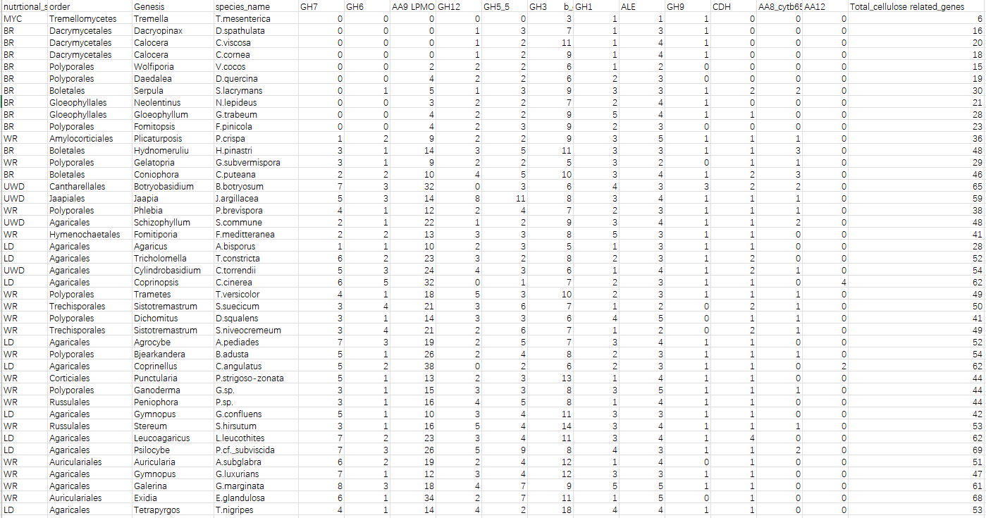
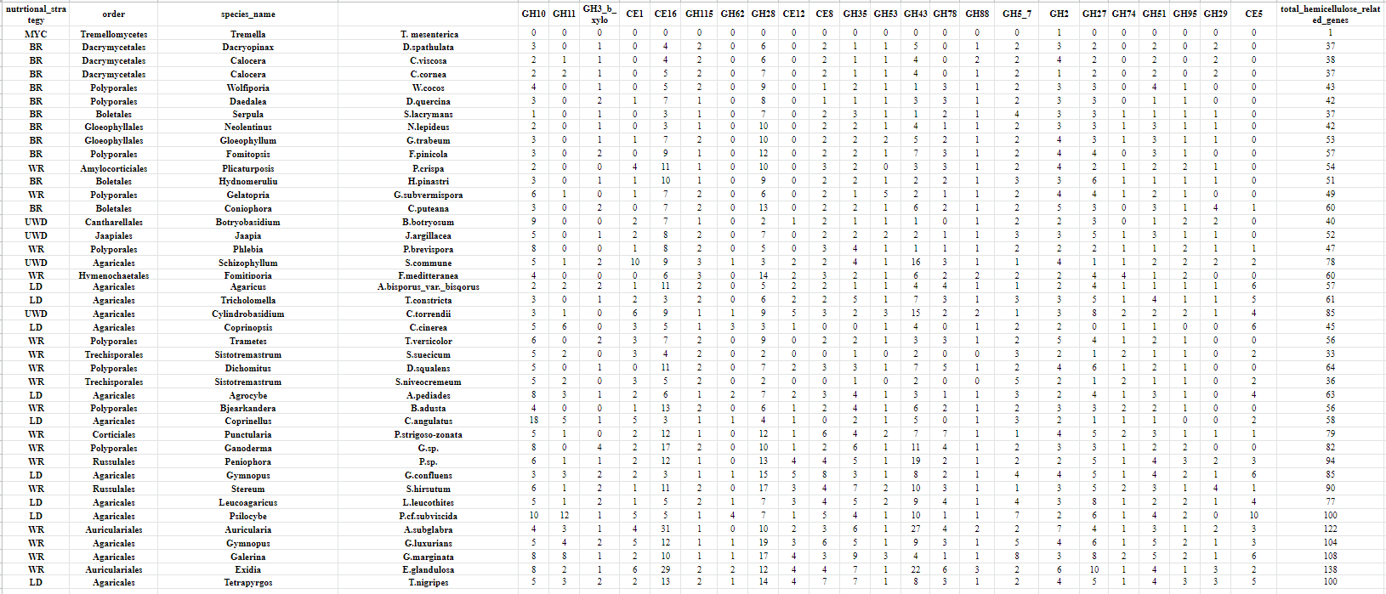
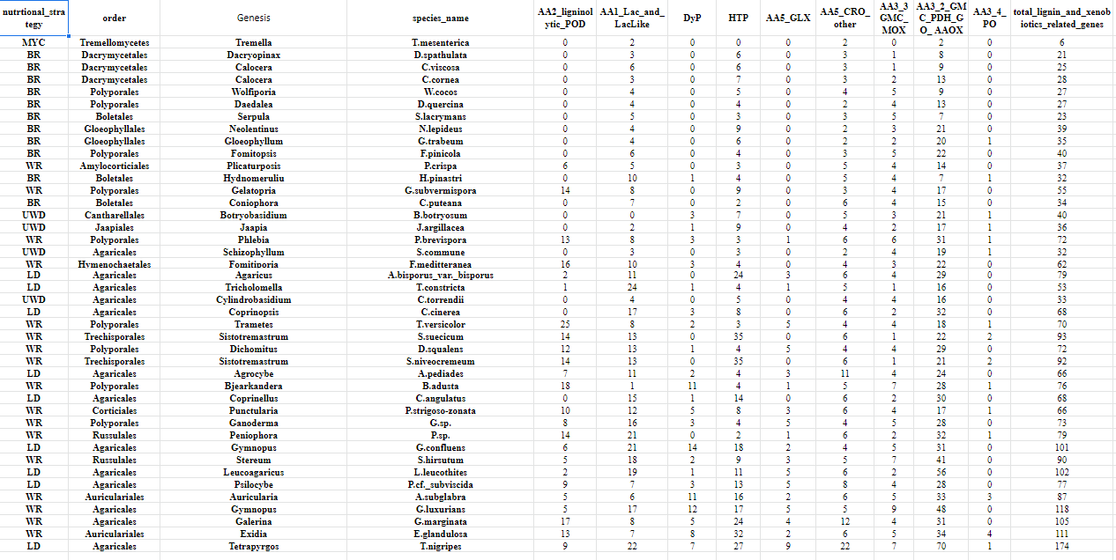
Methods

Slide 8
Methods
Now that dataset was split into three different Excel files we performed the following in each:
Created first pivot tables by nutritional strategy and total genes related to the PCW component.
White-rot (WR)- digest cellulose and lignin
Brown-rot (BR)- digest cellulose, leave ligning behind
Litter decomposer(LD)
Mycoparasites (MYC)
Uncertain types of wood-decay(UWD)
Second, pivot table by order and total genes related to PCW given PCW compound.
Third, pivot table by genus and total genes related to PCW compound.
Notes:
(Floudas et al., 2020) used for definition of nutritional strategy.
LD prefer to decompose leaf lignin

Slide 9

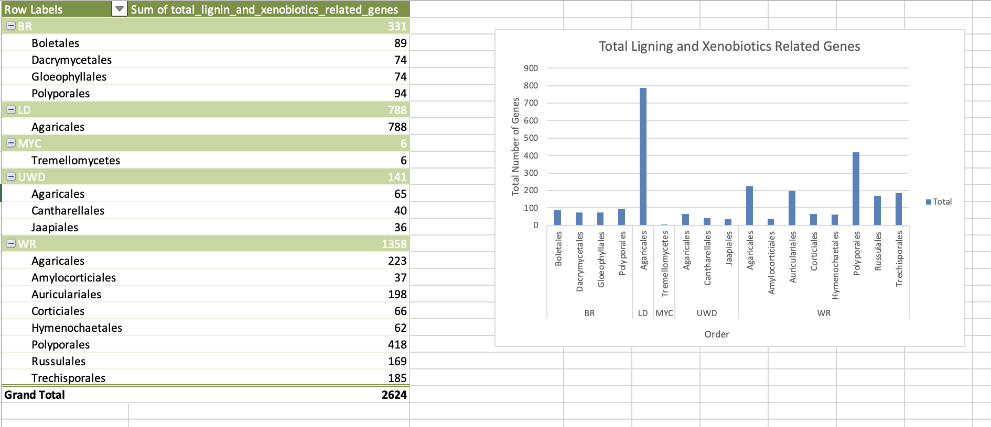
Methods

Slide 10
Results: Cellulose
Nutritional Strategy
Order
Genus
From the pivot table we made, we notice that the White-rot nutritional strategy has the most related genes, which is 799. Litter decomposers presented 482 related genes which is in the second place.
On the other hand, Mycoparasites only present 6 related genes.
Out of the pivot table we noticed that Agaricales presents the most related genes, which is 692.
However, Tremellomycetes only presenting 6 related genes.
In this part, we notice that Sistotremastrum presents 99 related genes, and Gymnopus presents 89 related genes which is close to the first place.
Tremella presents the least related genes in this part, which is 6 related genes.

Slide 11
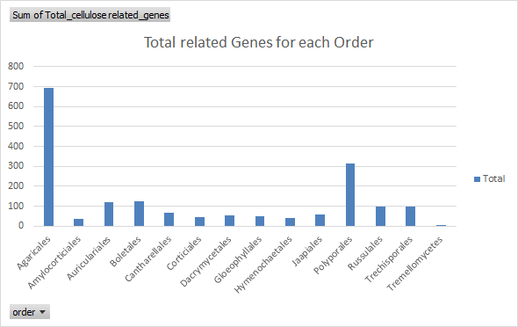
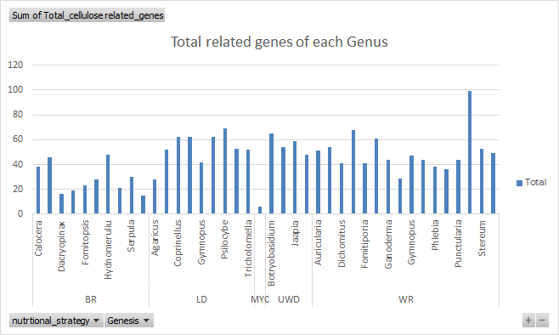
Results: Cellulose

Slide 12
Results: Hemicellulose
Nutritional Strategy
Order
Genus
White-rot and litter decomposers presented with 1272 and 646 total genes, respectively.
Mycoparasites had only 1 related genes.
Agaricales has the most related genes presented, 1021.
Tremellomycetes in this case only shows 1 related gene.
For hemicellulose, Gymnopus shows the most related genes, 189.
Tremella shows only 1 related gene.

Slide 13
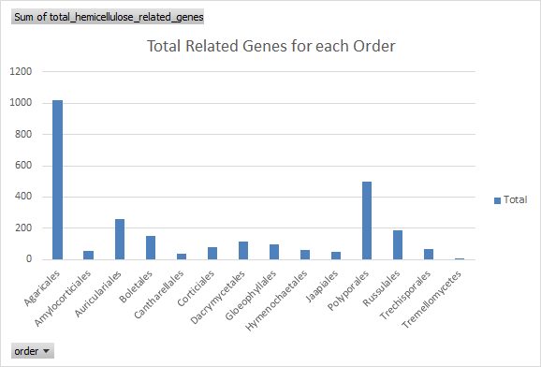
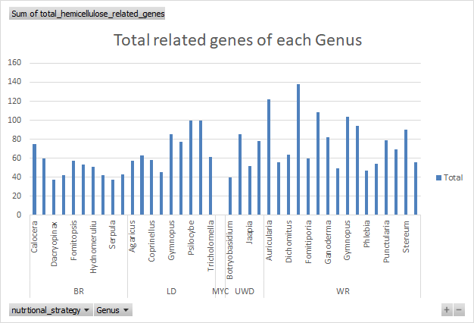
Results: Hemicellulose

Slide 14
Results: Lignin and Xenobiotics
Nutritional Strategy
Order
Genus
White-rot and litter decomposers presented with 1358 and 788 total genes, respectively.
Mycoparasites had only 6 total genes.
Most notably order Agaricales presented with 1076 total genes, followed by order Polyporales with 512 genes.
Tremellomycetes presented with the least, 6 genes.
Genus Gymnopus, Sistatremastrum, and Tetrapyrgos, presented the most genes with 219, 185, and 174 respectively.
Genus Tremella presented with the least, 6 genes.
Notes:
- “Xenobiotic is a term used to describe chemical substances that are foreign to animal life and thus includes such examples as plant constituents, drugs, pesticides, cosmetics, flavorings, fragrances, food additives, industrial chemicals and environmental pollutants” (Patterson, Gonzalez, & Idle, 2010)

Slide 15
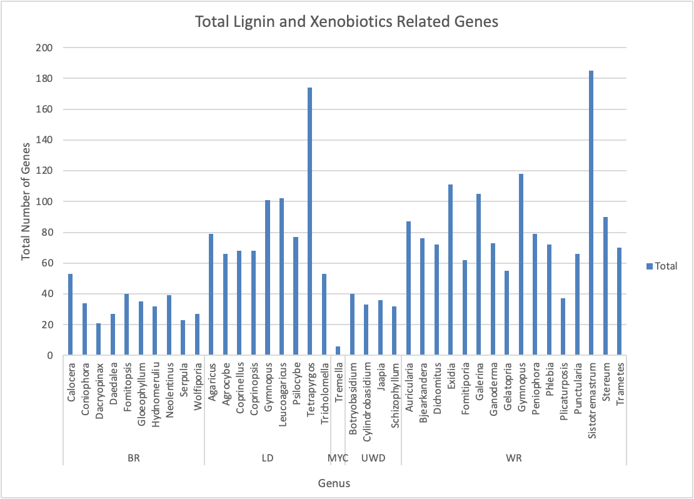
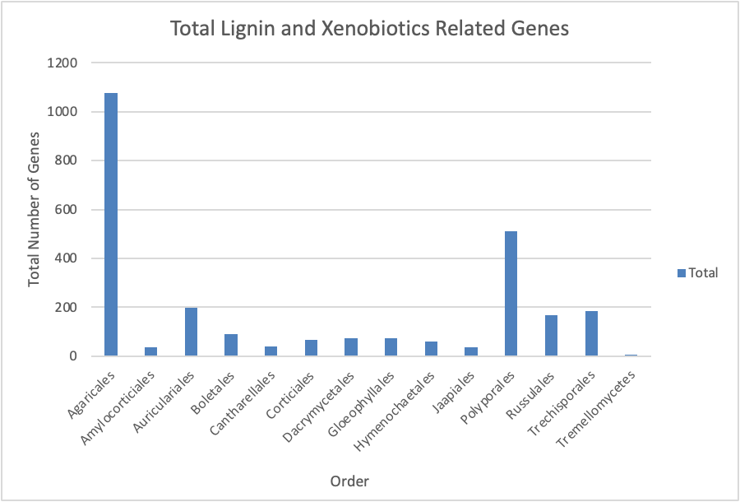
Results: Lignin and Xenobiotics

Slide 16
Conclusion
Based on our analysis, we have found which genuses of mushrooms shows the most relevant genes for the breakdown of different plant cell wall components.
Cellulose: Sistotremastrum (Order: Trechisporales)
Hemicellulose: Gymnopus (Order: Agaricales)
Lignin and Xenobiotics: Gymnopus (Order: Agaricales)
Future directions: Finding out the rate of decomposition of plant material by the fungi that had the most PCW degrading genes. To prove our hypothesis, we would need to expose the organisms to different environments and plant materials in a controlled environment and look at the efficiency of each fungi under given conditions.

Slide 17
References
Biogeochemical cycles (2011) Available at: https://scied.ucar.edu/learning-zone/earth-system/biogeochemical-cycles [Accessed November 30, 2021].
Floudas D, et al. (2020) Uncovering the hidden diversity of litter-decomposition mechanisms in mushroom-forming fungi. The ISME Journal 14(8):2046–2059.
Mayer M, et al. (2021) Soil fertility relates to fungal mediated decomposition and organic matter turnover in a temperate mountain forest. New Phytologist 231(2):777–790.
Microsoft (2021) Microsoft Excel for Mac. Microsoft 365. Available at: https://www.microsoft.com/en-us/microsoft-365/excel [Accessed November 29, 2021].
Patterson, A. D., Gonzalez, F. J., & Idle, J. R. (2010). Xenobiotic metabolism: A view through the metabolometer. Chemical Research in Toxicology, 23(5), 851–860. https://doi.org/10.1021/tx100020p
Rawlings A, et al. (2021) Metabolic responses of two pioneer wood decay fungi to diurnally cycling temperature. Journal of Ecology. doi:10.1111/1365-2745.13716.
Tomer A, et al. (2021) Role of fungi in bioremediation and Environmental Sustainability. Fungal Biology:187–200.
Weil RR, Brady NC (2017) 11-12. Nature and Properties of Soil (Pearson Prentice Hall), pp 464–581. 15th Ed.

